Slide 1
Yasmina DALI YOUCEF
1 year PHD student
Site: IUT , IMT , FST
CPS3 , NaoMod , VELO
Olivier CARDIN
Pascal ANDRE
Erwan BOUSSE

Slide 2
Modeling and configuration generation of reconfigurable manufacturing systems
R.O.D.I.C

Slide 3
R.O.D.I.C
Rapid recOnfiguration of manufacturing systems : a model-baseD software engineering and human Interaction Coupled approach
Why ?
Notes:
Aims to provide the industry operator with the ability to reconfigure Reconfigurable Manufacturing Systems (RMS) and equip them with evaluation tools to choose the configuration that best meets the needs.

Slide 4
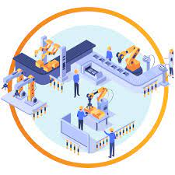
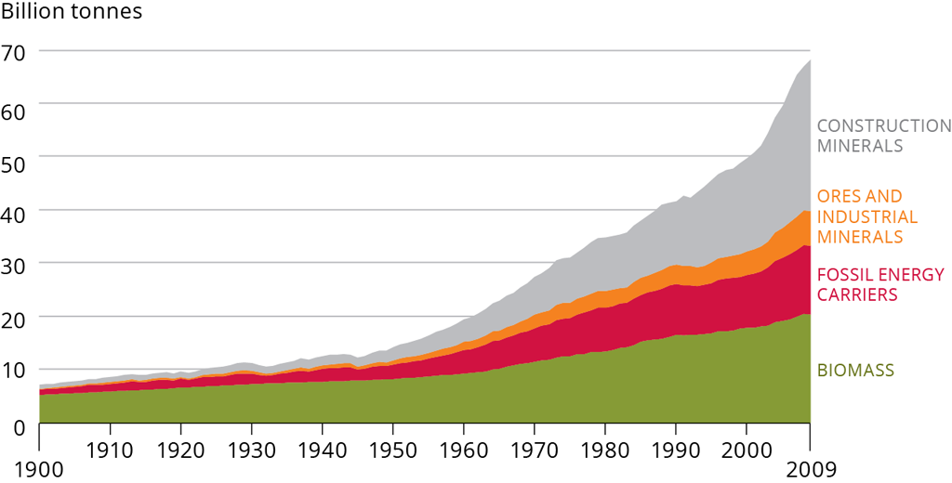
- Global crisis of COVID-19 and increased customer demands.
- Escalating competition among companies and supply chains.
- Focus on sustainable manufacturing.
- Growing need for customizable products.
- Creation of a more complex manufacturing environment.
- Intensified competition and constant change.
-Rapid development of new information technology. -Digital twins extensively used in smart manufacturing.
- Extend the manufacturing system's life cycle.
- Adapt to changing market conditions.

Slide 5
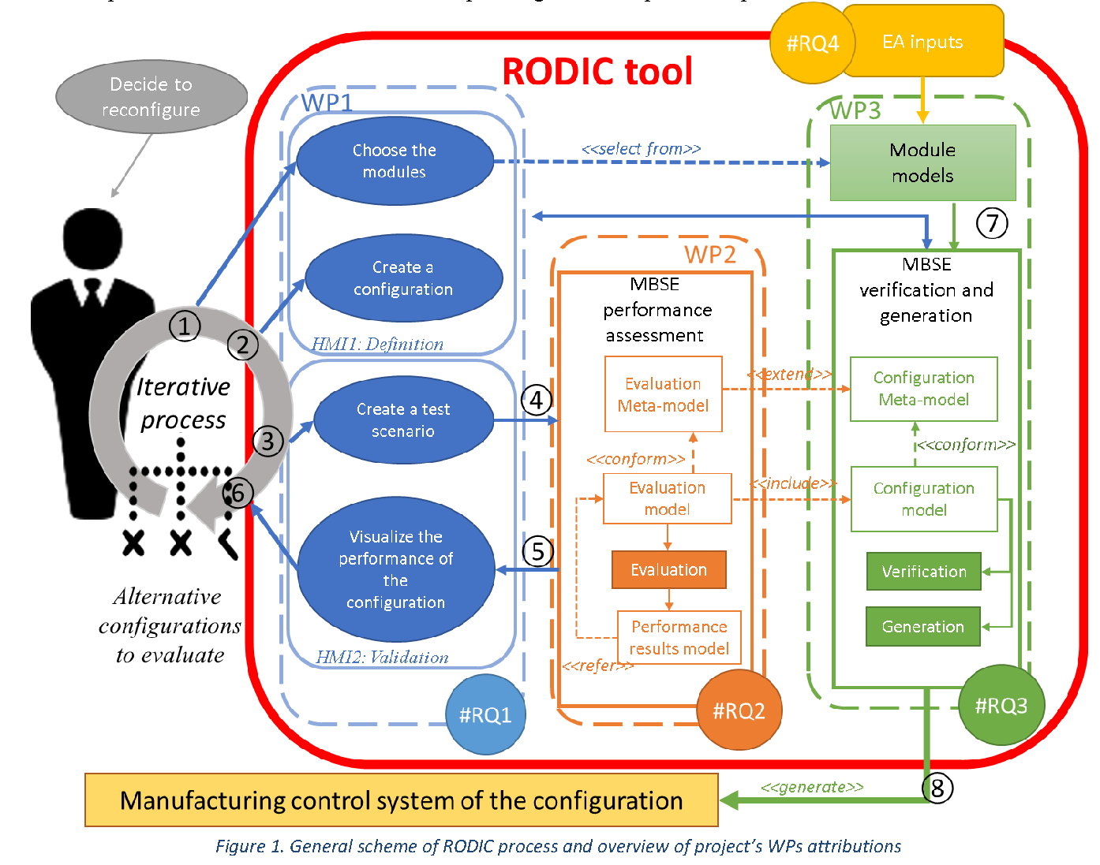
R.O.D.I.C

Slide 6
Modeling and configuration generation of reconfigurable manufacturing systems
Industrial engineering
Model-driven engineering
Software engineering

Slide 7
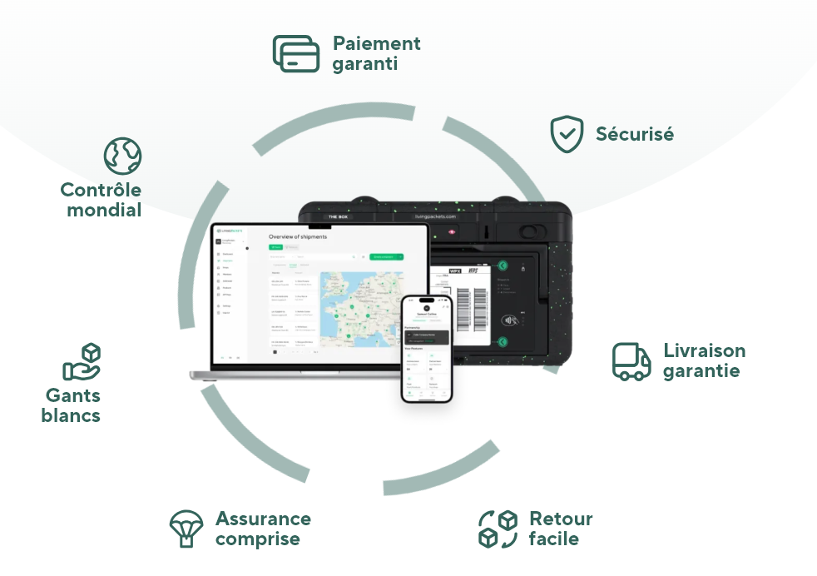
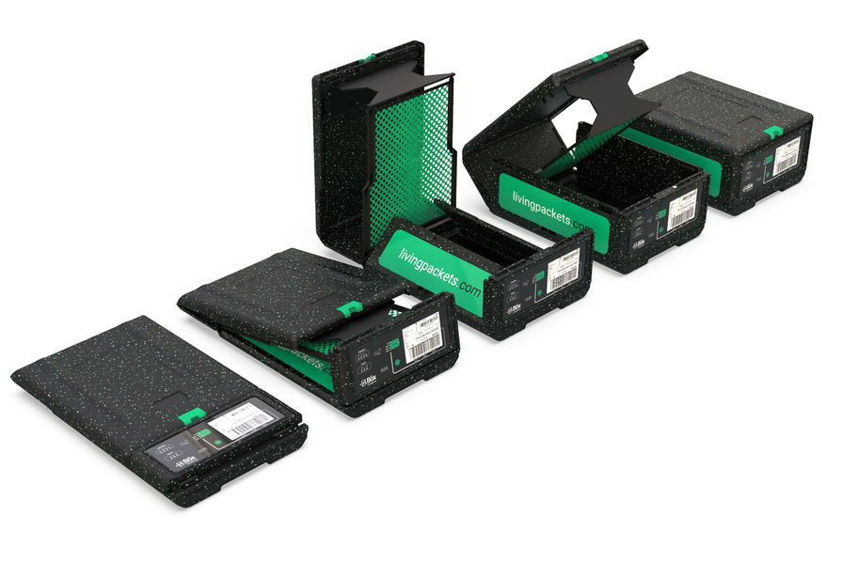
First Case Study : LivingPackets

Slide 8
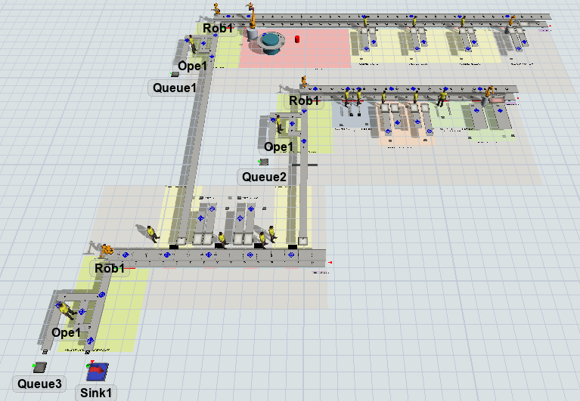
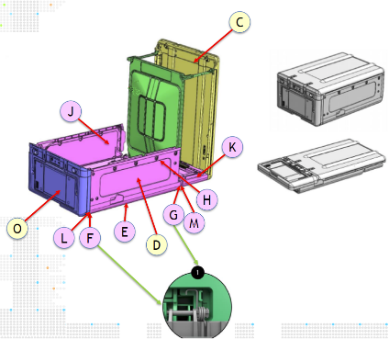
LAFF : Ligne d'assemblage du panneau avant [Assemblage de la face avant de ligne ]
LAB : Ligne d'assemblage de carrosserie [Assemblage de carrosserie de ligne]
LAF : Ligne d'assemblage de la boîte [Assemblage final de ligne]

Slide 9
Modeling and configuration generation of reconfigurable manufacturing systems
Industrial engineering
Model-driven engineering
Software engineering

Slide 10
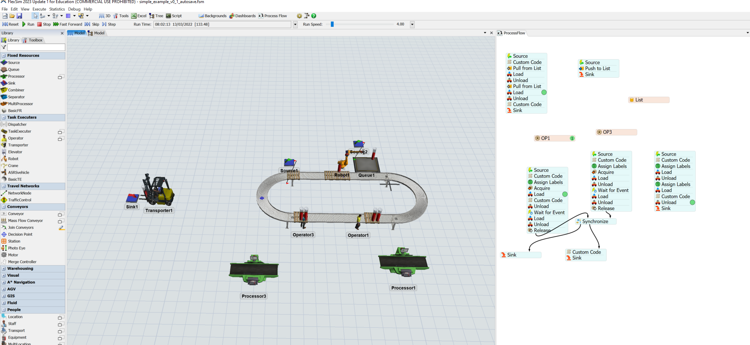
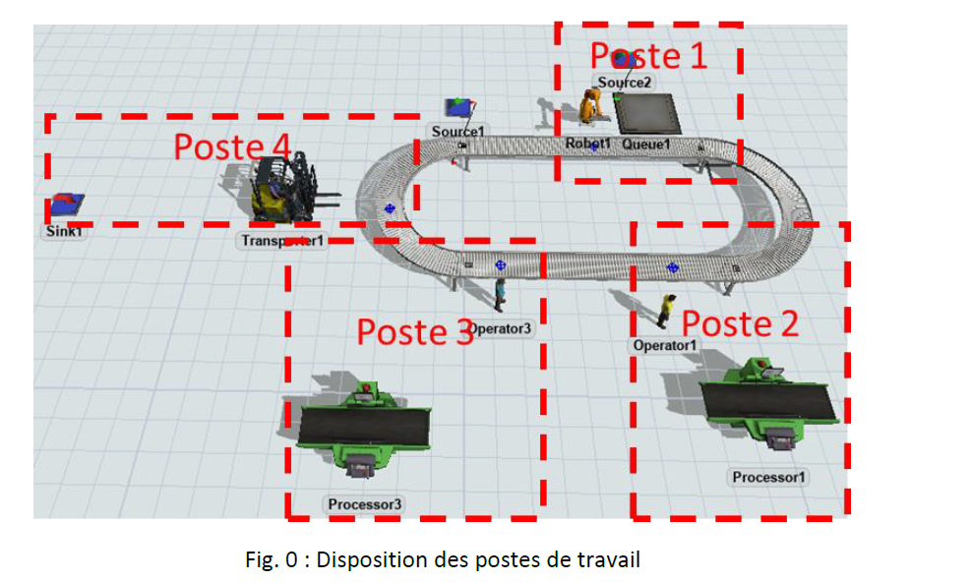

Slide 11
RODIC DSL

Slide 12
RODIC DSL
Structural
RunTime/Simulation
Behavior

Slide 13
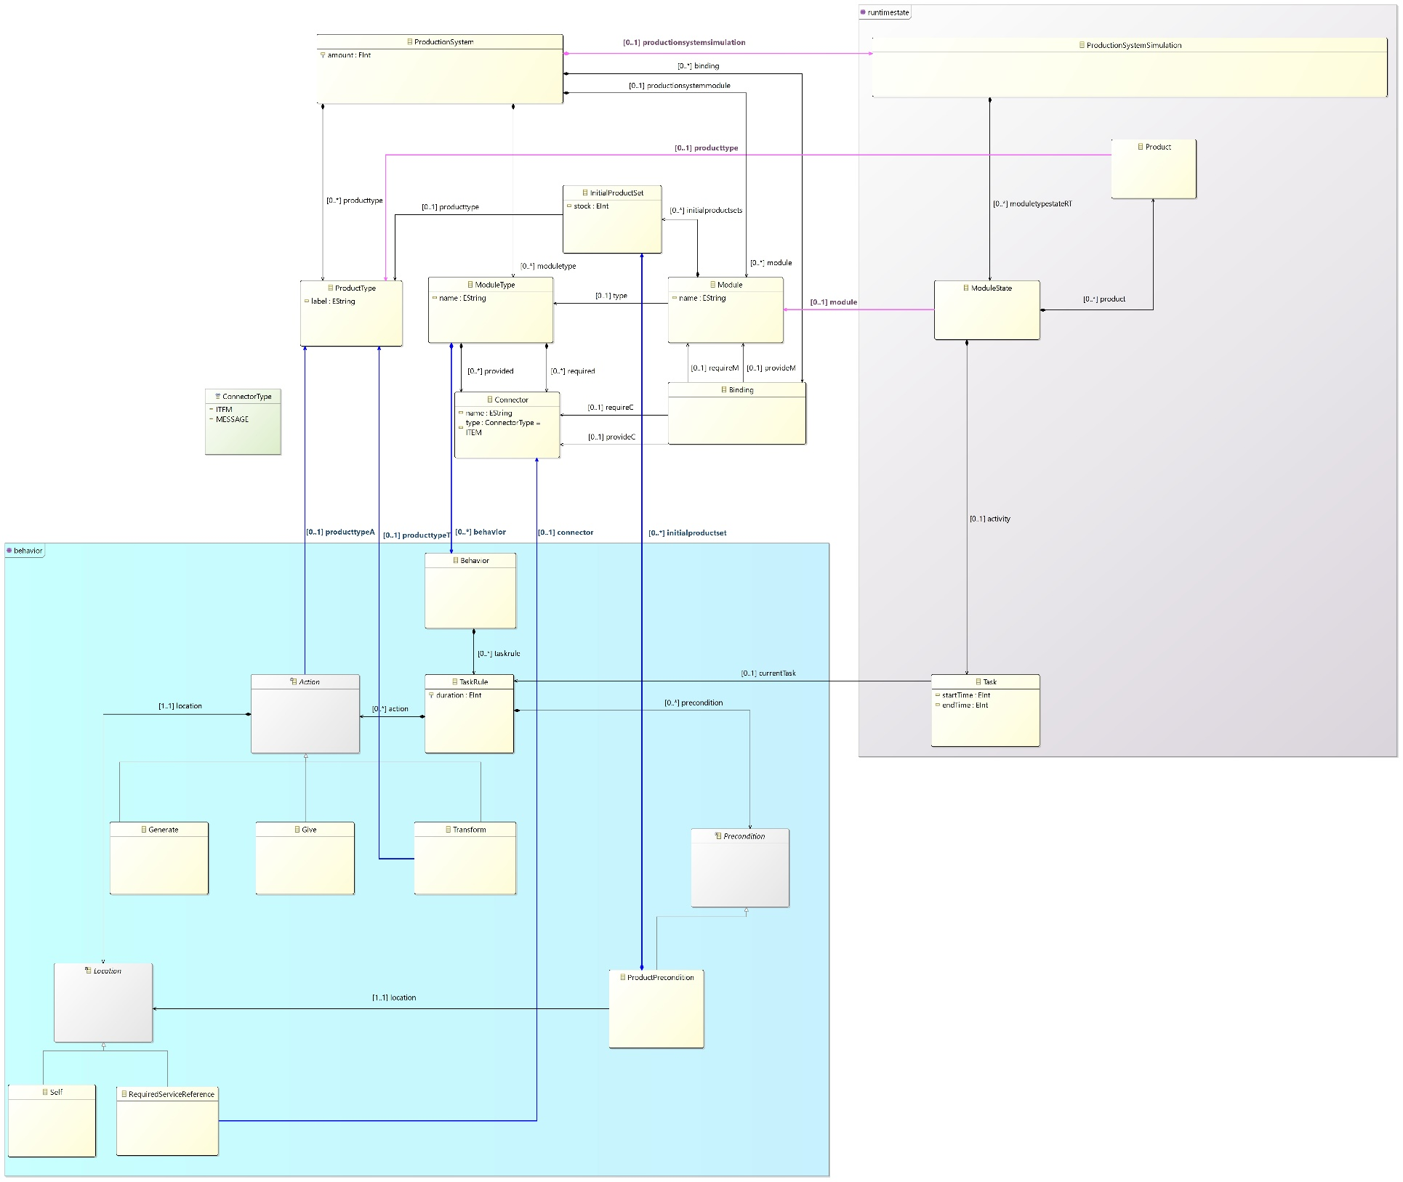
RunTime/Simulation
RODIC DSL
Structural
Behavior

Slide 14
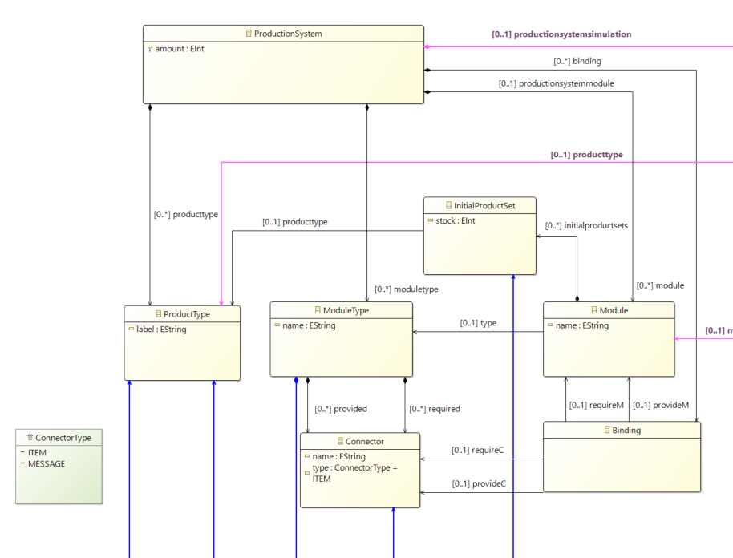
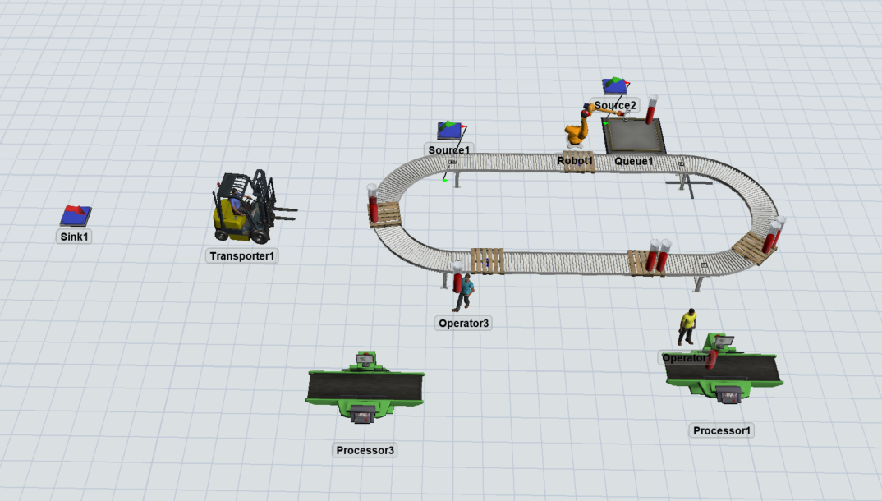

Slide 15
InP
ProcessProduct
OutProduct
PT1
PT2
PT1
PT1
PT1
StartProduct
StartPalette
Exit
S
Process2
Process1

Slide 16
RunTime/Simulation
RODIC DSL
Structural
Behavior

Slide 17
How the consept of « Time » will work

Slide 18
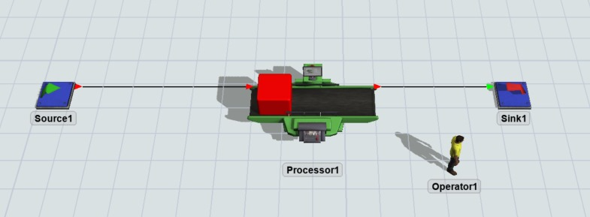
New product in source take 3t
Process take 2t
No time for exit needed
t= 0
Source start task → end at t = 3
Process stand by
Sink stand by
t=3
Source end task → Source add to Process / Source start task → end at t=6
Process start task → end at = 5
Sink stand by
t=5
Source on going
Process end task → Process add to Sink
Sink stand by
t=6
Source end task → Source add to Process / Source start task → end at t=9
Process start task → end at = 8
Sink stand by

Slide 19
YOU SHALL NOT ASK

