Slide 1
Bridge between Agile and Traditional: Structuring Agile Requirements Documentation
Hind Wissam KALFAT, Mourad OUSSALAH, Azeddine CHIKH
23/05/2024
VELO meeting

Slide 2
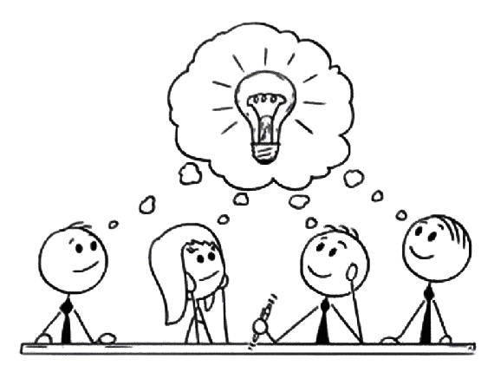
Undestand needs
Translate needs to requirements
Find a solution
Product=Software
Unclear needs
Stakeholders are the source of requirements
Customer: Stakeholders
Software engineers
SRE
Defining, analysing,
documenting, and maintaining requirements
Project team
Development process
Final product

Slide 3
BABOK: A Guide to the Business Analysis Body of Knowledge
The BABOK states that Requirements include, but are not limited to, the past, present and future conditions or capabilities of a business, as well as descriptions of organisational structures, roles, processes, policies, rules and information systems

Slide 4
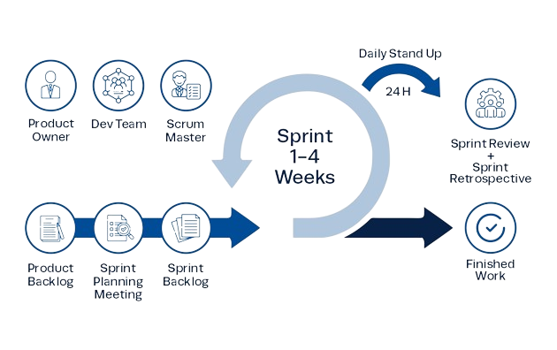
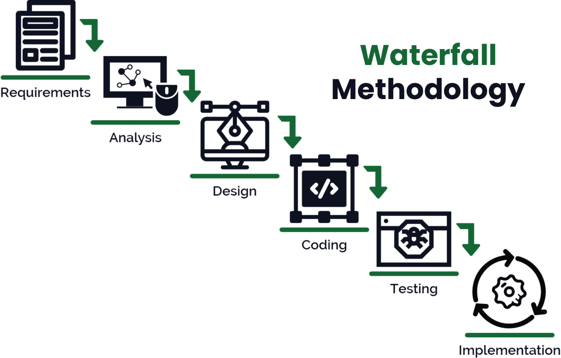
Background
SRE can be performed using either agile or traditional methods.
In agile RE (ARE) the requirements activities in agile are performed iteratively and carried out in collaboration with the stakeholders.
In traditional RE (TRE) all requirements are elicited, analysed and documented before the actual development process begins.
Requirement activities

Slide 5
Background
Documentation in traditional VS agile:
Traditional teams document all discussed requirements and produce the software requirement specification SRS.
This SRS is supported by additional documents describing other types of requirements.
To facilitate the documentation process in TRE, several templates are available, enabling the team to maintain a precise structure.
At the final stage, all documented requirements have to be implemented afterwards.

Slide 6
Background
Documentation in traditional VS agile:
In agile, teams tend to minimise documentation in order to focus on software development.
Agile developers consider documentation to be an important issue
Agile teams use a variety of artefacts to define requirements
=>These dissimilarities can have significant consequences, especially in cases of hybrid development

Slide 7
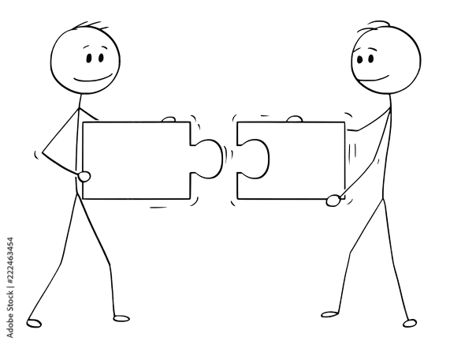
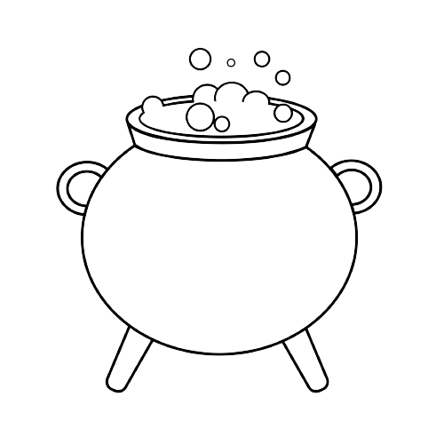
Context
Hybrid development involves integrating both agile and traditional approaches
Traditional
Agile
Using agile techniques in a traditional process
Using agile for certain scenarios and traditional for others
T
A
Project
Mixing agile and traditional in one project
Collaboration of agile and traditional teams

Slide 8
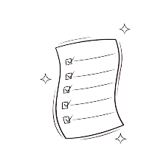
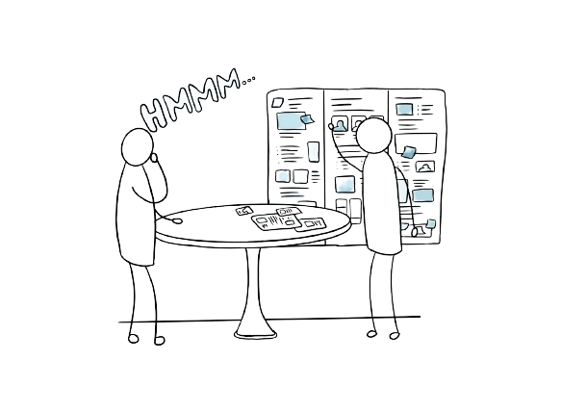
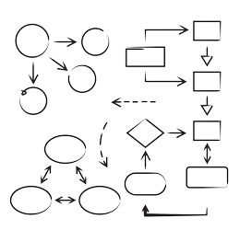
Objectives
(2) Structuring agile documentation artefacts, using a third mapping metamodel, according to a traditional documentation structure.
(1) A specification through metamodels for both agile and traditional RE, specifically from the point of view of documentation
(3) Presentation of a case study demonstrating the application of ARDocS approach.

Slide 9
Related works
Agile and traditional specification
Techniques for structuring agile documentation (Mind-mapping/ Conceptual models)
Hybrid development
Metamodeling approach

Slide 10
ARDocS architecture.
ARDocS: Agile Requirement Documentation Structuring
M3A
M3T
M2A
M2T
Notes:
we assume the role of agile and traditional methodologists in modelling meta-models and meta-metamodels at the M3 and M2 levels

Slide 11
ARE documentation Meta-metamodel.
ARDocS: M3A

Slide 12
TRE documentation Meta-metamodel.
ARDocS: M3T

Slide 13
Mapping Meta-metamodel.
ARDocS: Mapping

Slide 14
Scrum metamodel
ARDocS: M2A

Slide 15
VOLERE metamodel
ARDocS: M2T

Slide 16
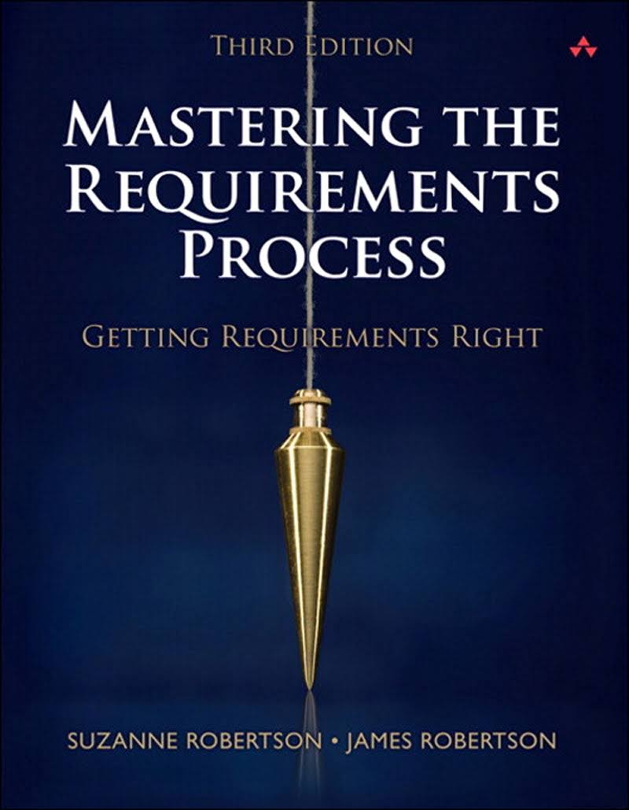
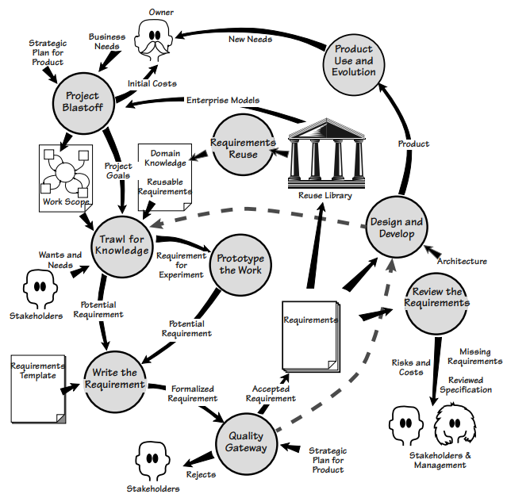
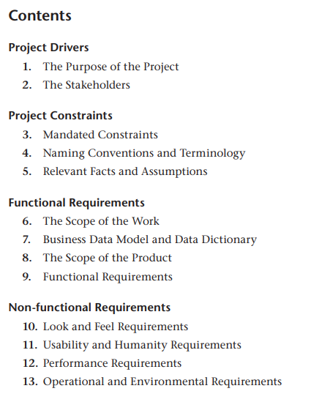
ARDocS: VOLERE
VOLERE process
VOLERE template

Slide 17
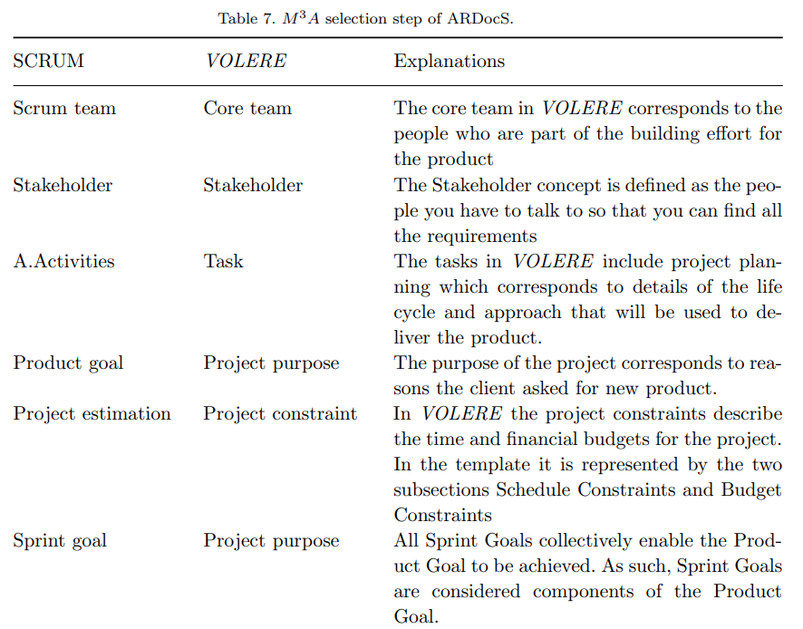
ARDocS: Selection

Slide 18
Conclusion
Validation of the approach: Real world/ Survey/ Case study.
Build our own case study.
Future work: integrate the solution with current documentation tools.

