Slide 1
Domain-Specific Languages for Automated Generation of Datasets for Industry 4.0 Applications
Brian Sal, Diego García-Saiz, Pablo Sánchez
Universidad de Cantabria
original paper accepted at the MEDI 2021 conference
extension submitted to the International Journal of General Systems
Notes:
Diego (assistant) = data science + software engineering
Pablo (associate professor) = model-driven engineering

Slide 2
Article

Slide 3
Context
Industry 4.0 Applications
applications dedicated to engineers in the industry
applications process massive data from heterogeneous sources, formats and storage engines
applications embedded data analysis algorithms (data mining)
Datasets
data analysis algorithms process tables, tabular data or datasets (1 row = 1 data)
data preprocessing required from linked or hierarchical data (ETL)

Slide 4
Issues
Dataset Generation
data transformation into tabular data structures
cumbersome tasks, low-level operations, labor intensive, time consuming, error prone
Automatic Dataset Generation
previous solution: Lavoisier, a DSL for dataset generation from object-oriented data models
industry engineers not educated to object-oriented data models ;(

Slide 5
Hypothesis
using MDE approach again
industry engineers familiar with fishbone diagrams
solution: fishbone diagrams → object-oriented diagrams

Slide 6
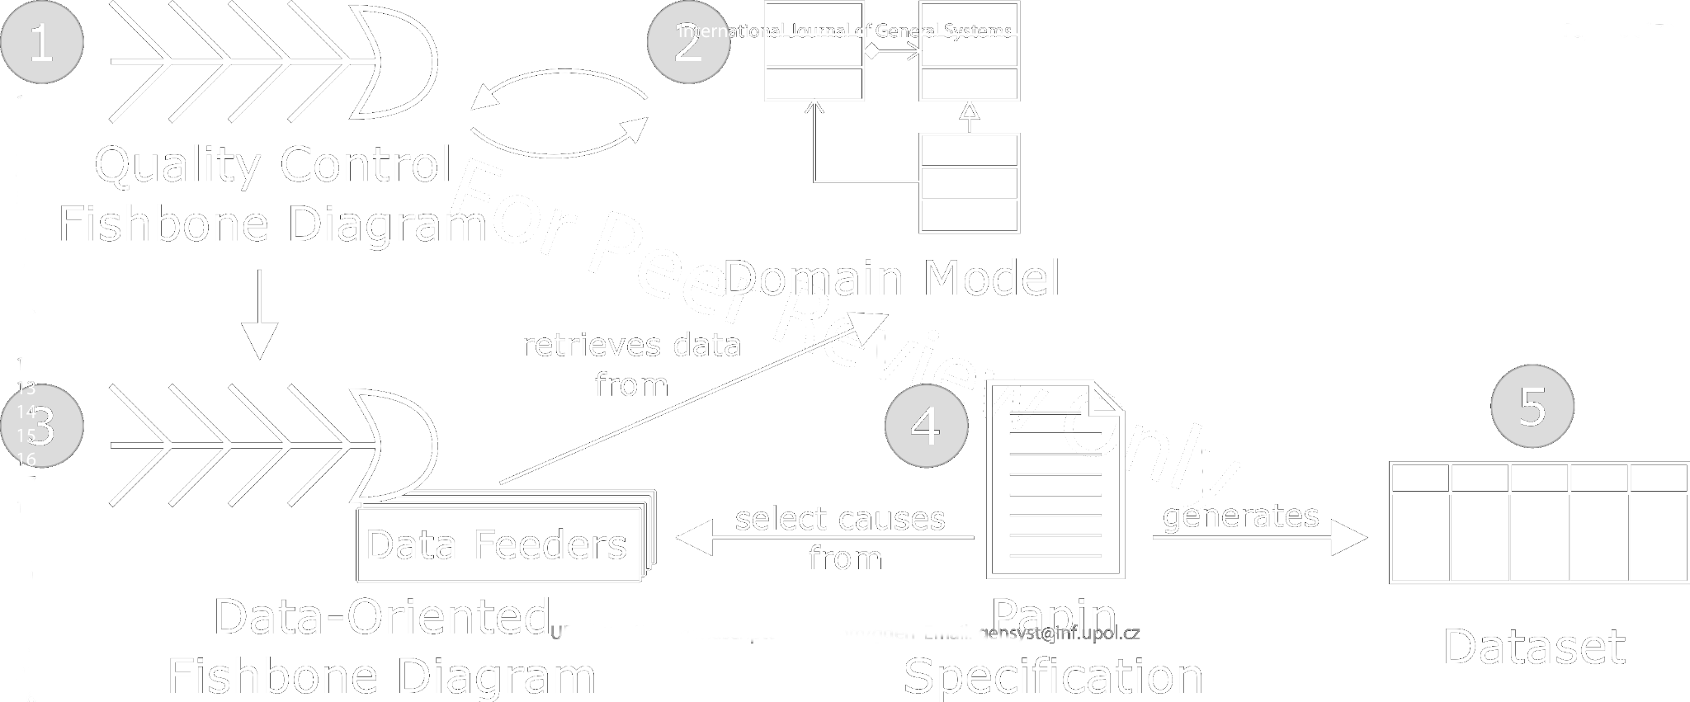
Contributions
data-oriented fishbone diagrams: fishbone diagrams + Lavoisier statements
Papin: a DSL, for dataset generation from object-oriented fishbone diagrams

Slide 7
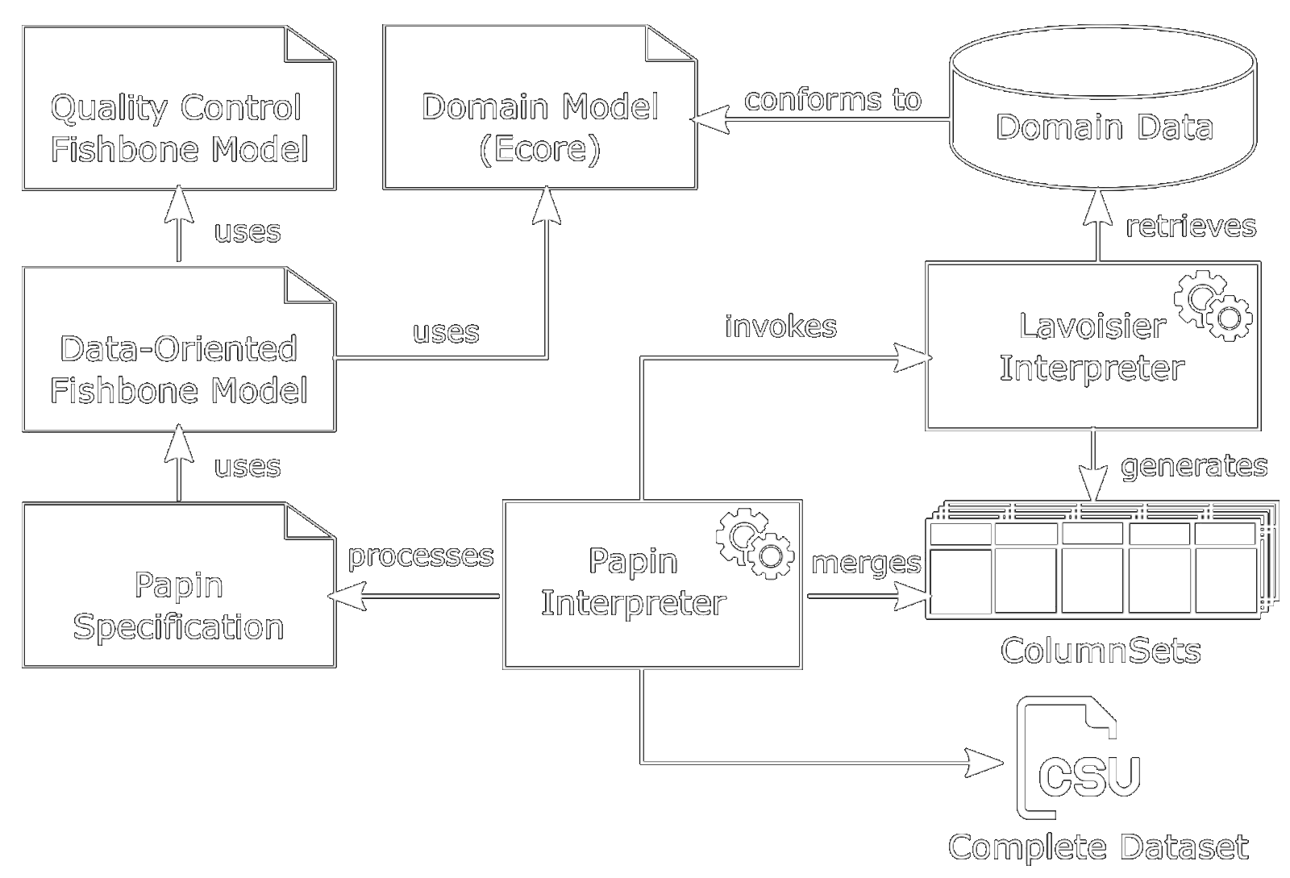

Slide 8
Contributions
data-oriented fishbone diagrams: fishbone diagrams + Lavoisier statements
Papin: a DSL, for dataset generation from object-oriented fishbone diagrams
deep evaluation over 5 case study
expressiveness
effectiveness

Slide 9
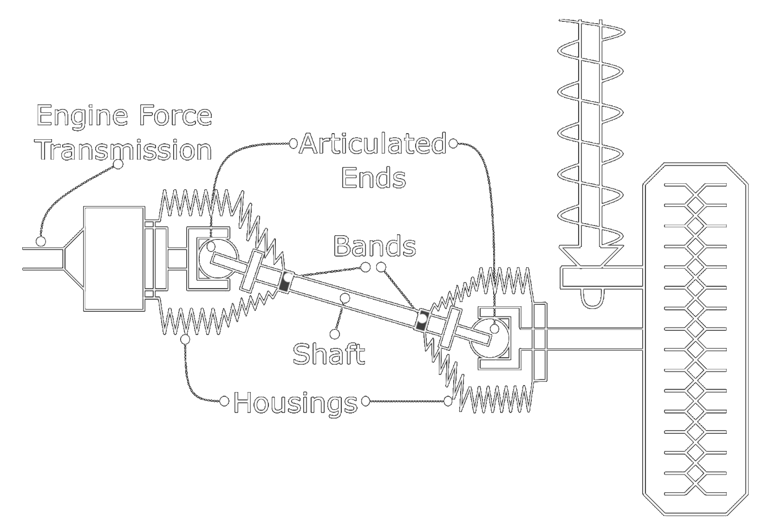
Object-Oriented Fishbone diagrams

Slide 10
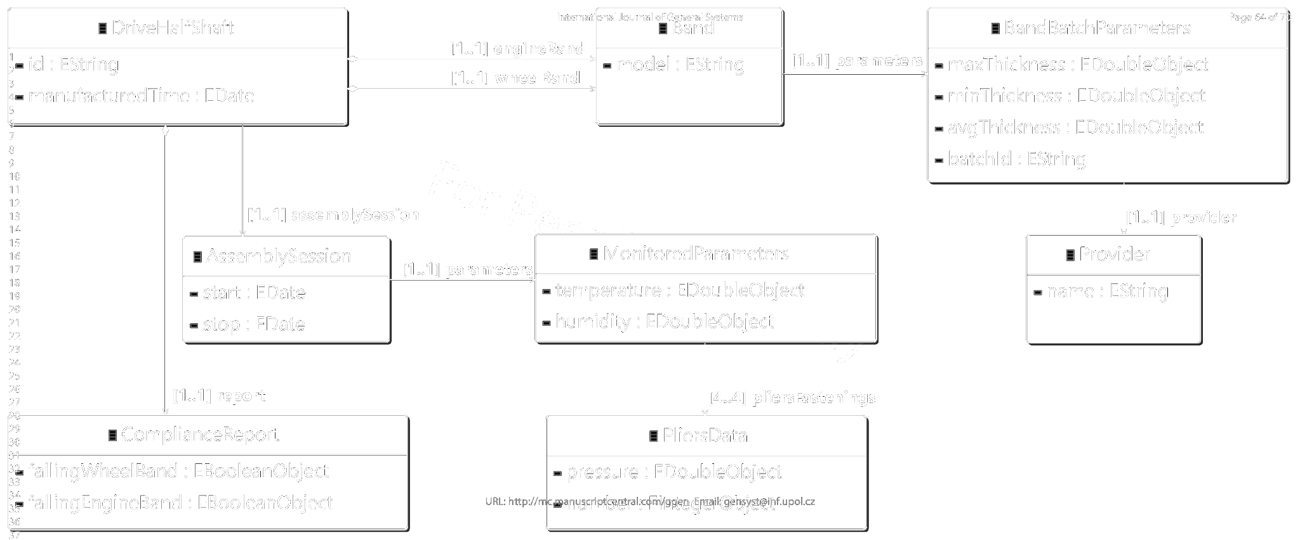
Object-Oriented Fishbone diagrams

Slide 11
Object-Oriented Fishbone diagrams
Notes:
Head = main effect
Backbone = set of all causes
Categories = set of causes
Cause = atomic or composed of causes

Slide 12
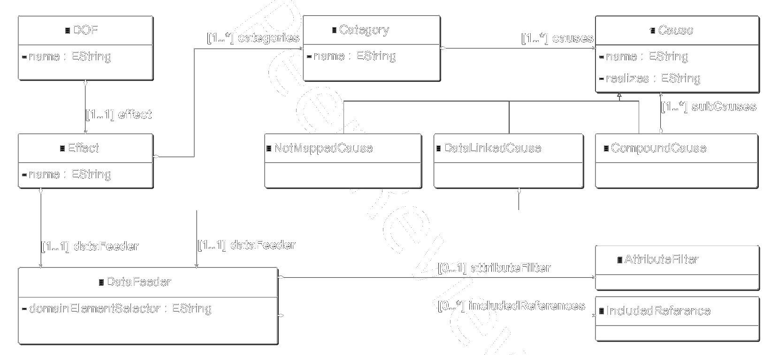
Object-Oriented Fishbone diagrams

Slide 13
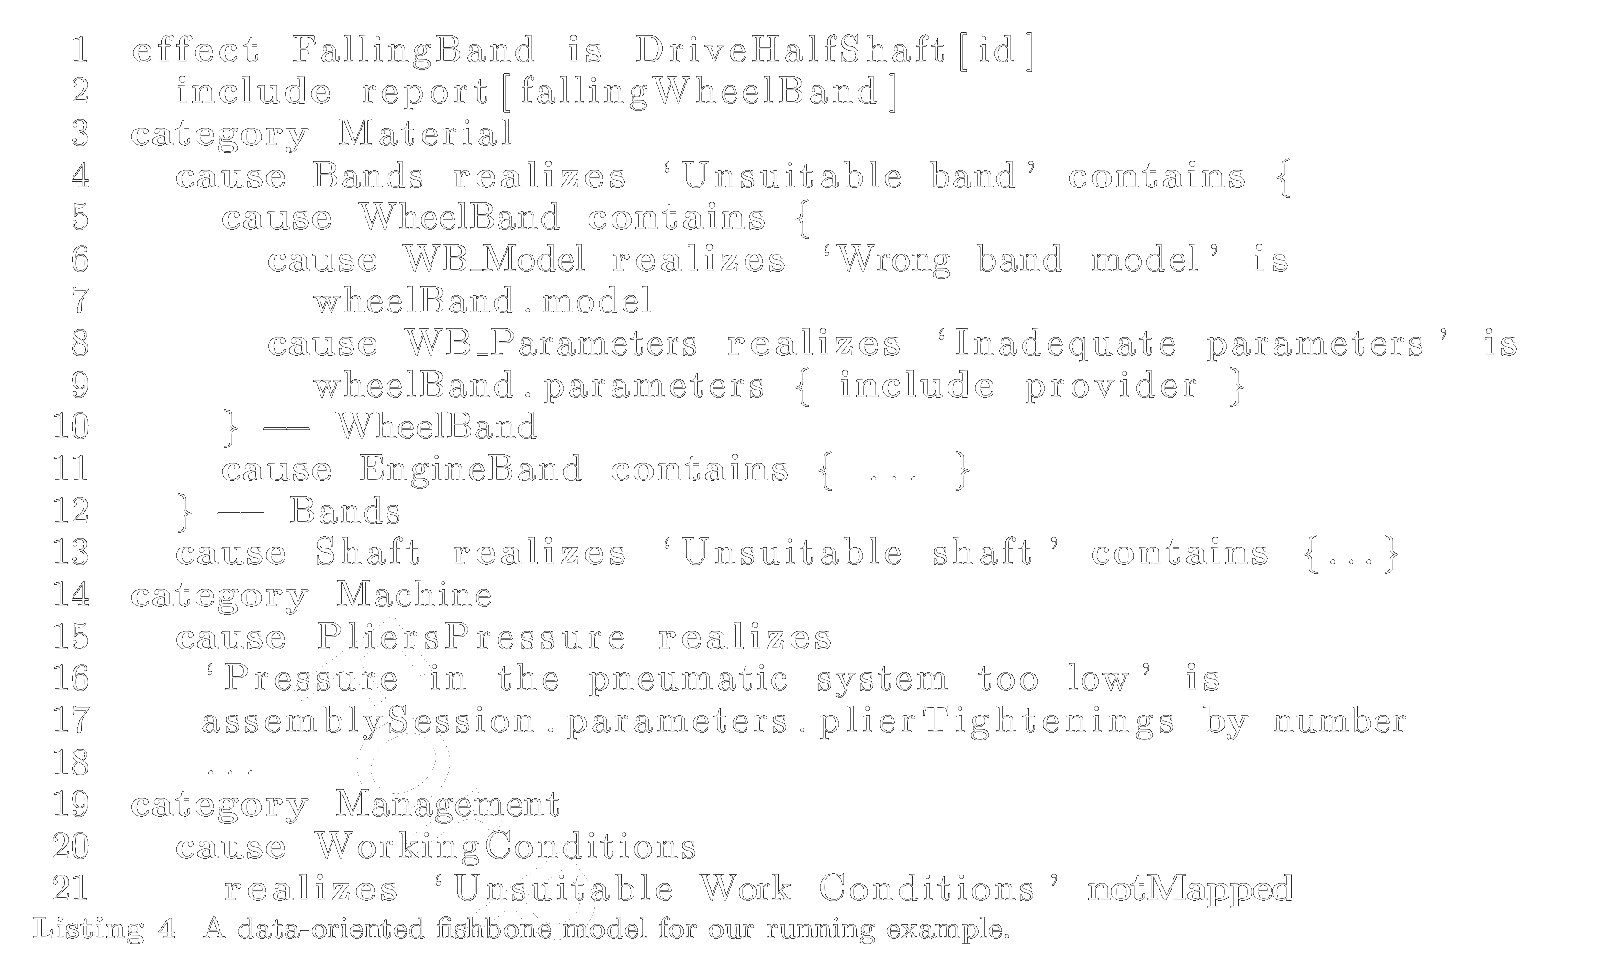
Object-Oriented Fishbone diagrams
Notes:
effect … is <data feeder
cause … is <data feeder>

Slide 14
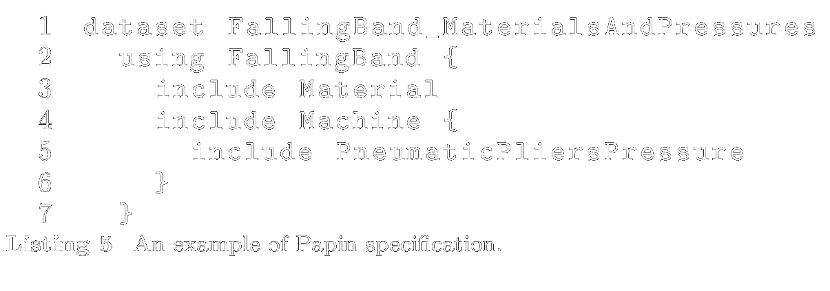
the Papin DSL

Slide 15
Evaluations
Expressiveness: can DOF and Papin be used in the industry?
Effectiveness: how much code can DOF and Papin save?

Slide 16
Evaluations – case study

Slide 17
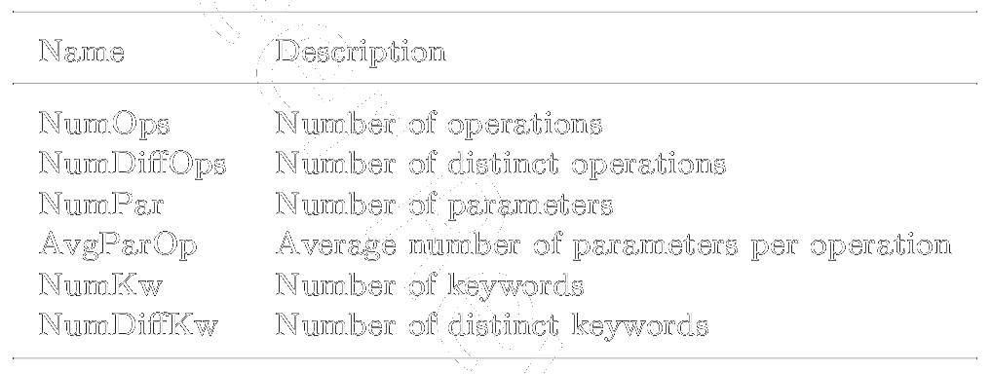
Evaluations – metrics

Slide 18
Evaluations – scenarios

Slide 19
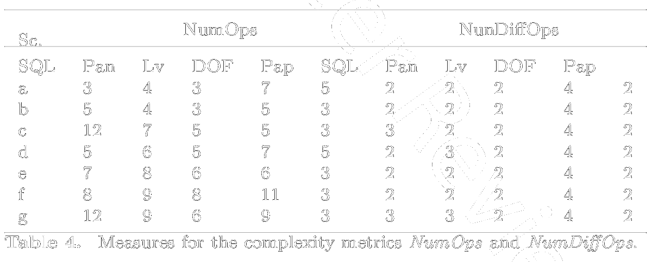
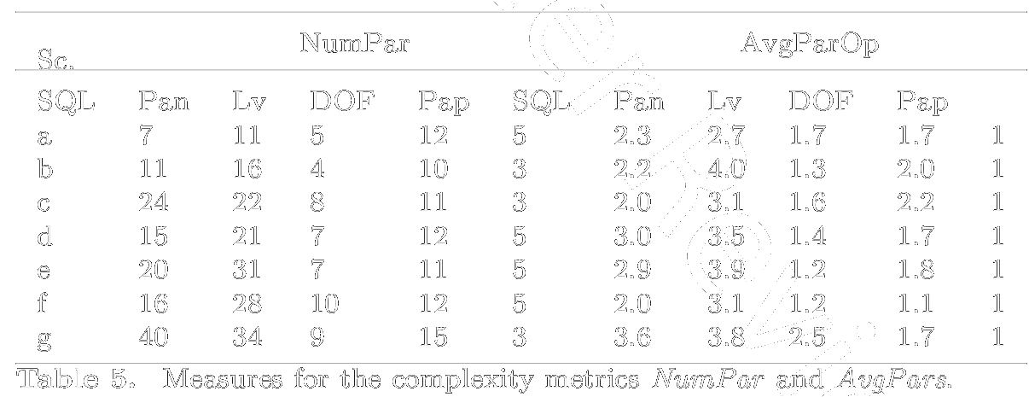
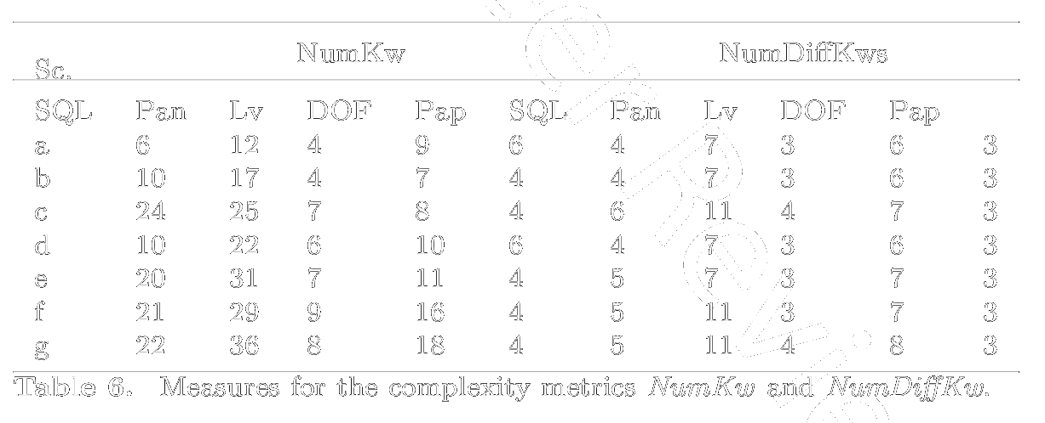
Evaluations – results

Slide 20
Review

Slide 21
Benefits
DOF as a bridge between cause analysis and domain data modeling
meta-model pretty well defined, explained and illustrated
relevant as providing a kind of semantics to QCF

Slide 22
Concerns
DFO seems to require some OODM knowledge
why not educating industry engineers directly with OODM?
how knowledge transfer is achieved between data scientists and industry engineers?
In fig. 7, Ind. Eng. = QCF, Data Sci. = Domain Model, ? = DOF, Papin
DOF: no diagram-based modelling, only text-based?
Papin is merely a language for selecting causes and sub-causes
what is the rationale behind that DSL? no argument really provided
could the running exemple show the relevance of Papin?
how the CSV files are generated? how Lavoisier really work? with references to domain data?
underlying process: Papin and Lavoisier plugins for ETL tools
process: Data Sci. first, Ind. Eng. second; reverse process better? Ind. Eng. Data Sci. second
Lavoisier and Papin integrated into Data Mining tool-sets, ecosystem, environments, etc
For instance I experienced the adoption of PowerBI in the industry without any worry

Slide 23
Concerns
expressiveness evaluation
the 5 study cases carried out are not that complex, are results meaningful?
usage of Eclipse, Java, EMF? xText, DSLs in the Industry?
lack of data analysis use case, lack of use-case oriented approach (that can legitimate DOF)
effectiveness evaluation
are metrics relevant wrt effectiveness?
the less operations / parameters / keywords, the better? I doubt it
evaluation
not assessed: cumbersome tasks, low-level ops, labor-intensive, time-consuming, error-prone
related works
no comparison to Pinset as part of Epsilon, a large MDE tool-set

Slide 24
Remarks
link between DOF and domain data not enough explained
evaluation scenarios a-g only related to case study #2
collecting and structuring the domain data is the most important task, isn’t it?

Slide 25
Thanks!

